Slide 1
The Architecture of PIER: an Internet-Scale Query Processor
(PIER = Peer-to-peer Information Exchange and Retrieval)
Ryan Huebsch
Brent Chun, Joseph M. Hellerstein,
Boon Thau Loo, Petros Maniatis,
Timothy Roscoe, Scott Shenker,
Ion Stoica, and Aydan R. Yumerefendi
p2p@db.cs.berkeley.edu
UC Berkeley and Intel Research Berkeley
CIDR 1/5/05
Notes:
OS/Net/DB researchers
Talk Geared for db audience, but all these viewpoints affected our research goals and system design

Slide 2
Outline
Application Space and Context
Design Decisions
Overview of Distributed Hash Tables
Architecture
  Native Simulation
  Non-blocking Iterator Dataflow
  Query Dissemination
  Hierarchical Operators
System Status
Future Work

Slide 3
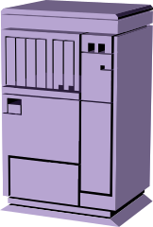



What is Very Large?
Depends on Who You Are
Single Site
Clusters
Distributed
10’s – 100’s
Internet Scale
1000’s – Millions
Database Community
Network Community
Challenges
  How to run database style queries at Internet scale?
  Can DB concepts influence the next Internet architecture?
Notes:
With title/ Mention VLDB 03 paper
DB pt of view: queries at Scale
Nets pt of view: using Db ideas for a new generation of Internet

Slide 4
Application Space
Key properties
  Data is naturally distributed
  Centralized collection undesirable (legal, social, etc.)
  Homogenous schemas
  Data is more useful when viewed as a whole
This is the design space we have chosen to investigate
  Mostly systems/algorithms challenges
  As opposed to …
    Enterprise Information Integration
    Semantic Web
    Data semantics & cleaning challenges
Notes:
Homogeneous schema = we’ll come back to this

Slide 5
A Guiding Example: File Sharing
Simple ubiquitous schemas:
  Filenames, Sizes, ID3 tags
Early P2P file sharing apps
  Napster, Gnutella, KaZaA, etc.
  Simple
  Not the greatest example
    Often used to violate copyright
    Fairly trivial technology
But…
  Points to key social issues driving adoption of decentralized systems
  Provide real workloads to validate more complex designs
Notes:
Define filesharing apps = file stealing
Simple = Gnutella built by small teams, used by thousands of non-expert college student

Slide 6
Example 2: Network Traces
Schemas are mostly standardized:
  IP, SMTP, HTTP, SNMP log formats, firewall log formats, etc.
Network administrators are looking for patterns within their site AND with other sites:
  DDoS attacks cross administrative boundaries
  Tracking epidemiology of viruses/worms
  Timeliness is very helpful
Might surprise you just how useful this is
Notes:
Networks do not work unless they are standardized
DOS = to evade detection
Tracking = Blaster worm spread rapidly, security people would love to see realtime info to determine threat levels
Timeliness = centralization not an option
Last = Network on PlanetLab (distributed research test bed) is mostly filled with people monitoring the network status/ all pairs ping

Slide 7
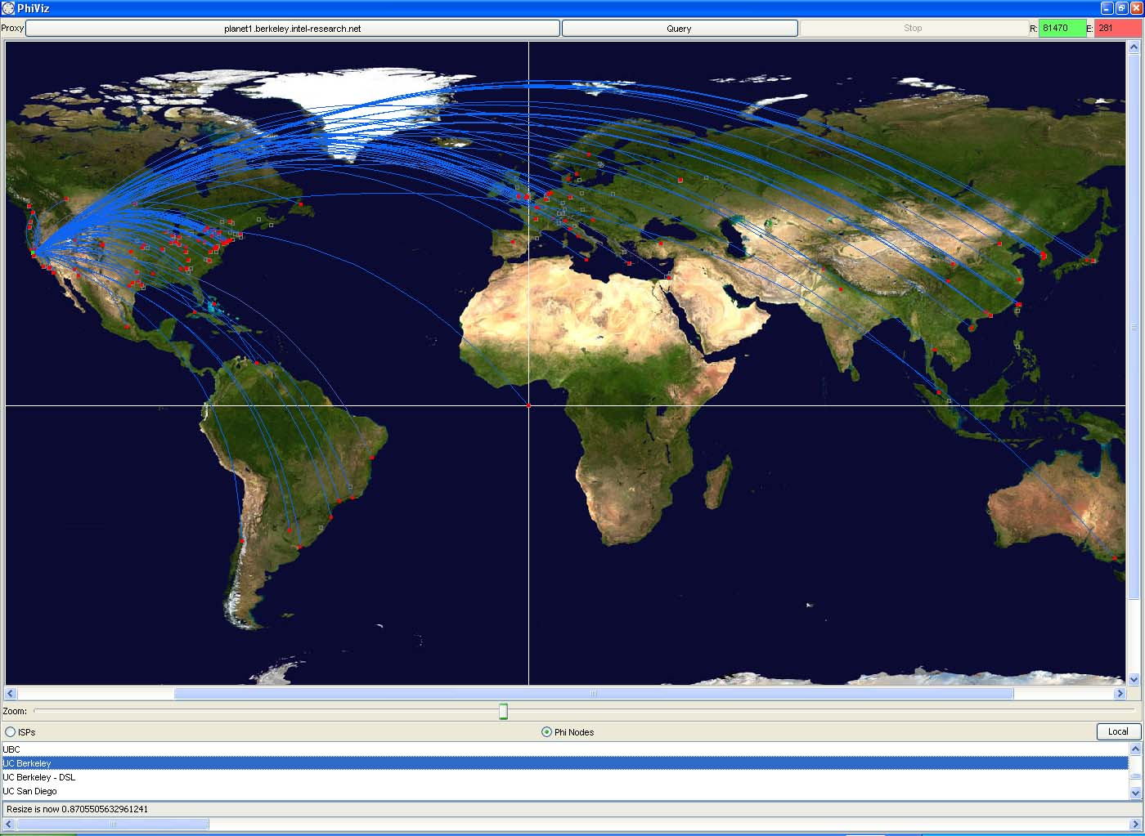
Notes:
Demo app we built using PIER
Shows the geographic locaiton of the source and destinations of firewall log events

Slide 8
Hard Systems Issues Here
Scale
Network churn
Soft-state maintenance
Timing/synchronization
No central administration
Debugging and software engineering
Not to mention:
  Optimization
  Security
  Semantics
  Etc.
Notes:
Scale = query broadcast on a tree not a bus, more generally, need to due things sublinearly using trees rather than lineraly
Churn = data and computation nodes changing constantly, must adapt particularly when executing CQ
Soft-State = in-network data must be periodically refreshed, causes tradeoffs in processing
Timing = use example, data before query
No central admin = everything bound at runtime, must tolerate all exceptions
Debugging and SW engineering = unexpected interactions in distributed system difficult to isolate and fix, will come up again in this talk

Slide 9
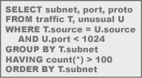
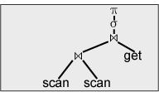
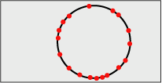
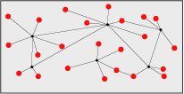
Context for this Talk
Core Dataflow Engine
Overlay Network
Physical Network
Declarative Queries
Query Plan
Notes:
You starting with a Declarative Query which is optimized to a query plan. The query plan then must be executed, rather than running directly on the physical network, use a layer of abstraction, an overlay network, to hid the complexities of the physical world.
This talk is about how we execute a query plan over a given overlay network
Snapshot and continuous queries
Recursive queries
“Boxes and arrows” dataflow engine

Slide 10
Initial Design Assumptions
Database Oriented:
  Data independence, from disk to network
  General-purpose dataflow engine
    Focus on relational operators
Network Oriented:
  “Best Effort”
  P2P architecture
    All nodes are “equal”
    No explicit hierarchy
    No single owner
  Overlay Network/Distributed Hash Tables (DHT)
    Highly scalable
      per-operation overheads grow logarithmically
      Little routing state stored at each node
    Resilient to network churn

Slide 11
Design Decisions
Decouple Storage
  PIER is just the query engine, no storage
    Query data that is in situ
    Give up ACID guarantees
  Why not a design p2p storage manager too?
    Not needed for many applications
    Hard problem in itself – leave for others to solve (or not)
Software Engineering
  Distributed systems are complicated
  Important design decision: “native simulation”
    Simulated network, native application code
  Reuse of complex distributed logic
    Overlay network provides this logic, with narrow interface
    Design challenge: get lots of functionality from this simple interface
Notes:
Traditinoal DBs couple storage to help provide ACID => We have to give it up anyway => data is already there, for example in filesharing the files are already in a filesystem
Leave for others = (examples are FarSight, Oceanstore, Ivy, Past, etc., these systems are still being developed)
Distributed systems are complicated = debugging is hard, there a few tools, [[ WAR STORY ]]
Native simulation = we’ll come back to these shortly<number>

Slide 12

Overview of
Distributed Hash Tables (DHTs)
DHT interface is just a “hash table”:
  Put(key, value), Get(key)
K V
K V
(K₁,V₁)
K V
K V
K V
K V
K V
K V
K V
K V
K V
put(K₁,V₁)
K V
get(K₁)
Notes:
Last point: Other DHT researchers tend to build single-function “systems” on top of DHT (e.g. SIGCOMM 2004: systems on agg query, or multi-d range query)

Slide 13
Integrating Network and Database Research
Initial design goal was to use the DHT →
became a major piece of the architecture
On that simple interface, we can build many DBMS components
  Query Dissemination
    Broadcast (scan)
    Content-based Unicast (hash index)
    Content-based Multicast (range index)
  Partitioned Parallelism (Exchange, Map/Reduce)
  Operator Internal State
  Hierarchical Operators (Aggregation and Joins)
Essentially, DHT is a data independence mechanism for Nets
  Our DB viewpoint led us to reuse DHTs far more broadly
Notes:
Last point: Other DHT researchers tend to build single-function “systems” on top of DHT (e.g. SIGCOMM 2004: systems on agg query, or multi-d range query)

Slide 14
Outline
Application Space and Context
Design Decisions
Overview of Distributed Hash Tables
Architecture
  Native Simulation
  Non-blocking Iterator Dataflow
  Query Dissemination
  Hierarchical Operators
System Status
Future Work

Slide 15
Native Simulation
Idea: simulated network, but the very same application code
  No #ifdef SIMULATOR
  What’s it good for
    Simulation: Algorithmic logic bugs & scaling experiments
    Native simulation: implementation errors, large-system issues
Architecture
  PIER use events not threads
    Nice for efficiency, asynchronous I/O
    More critical: fits naturally with discrete-event network simulator
  Virtual Runtime Interface (VRI) consists only of:
    System clock
    Event scheduler
    UDP/TCP network calls
    Local storage
  At runtime bind the VRI to either the simulator or the OS
Notes:
#ifdef = a matter of discipline not to do special case code -> insures you debug the real code
Large-systems issues = many components, interaction of components
Discrete-event = standard practice
VRI = layer of indrection, challenging to decouple what needs to be simulated, we were able to make that very narrow consisting only of the system clock, scheduler, and network calls

Slide 16
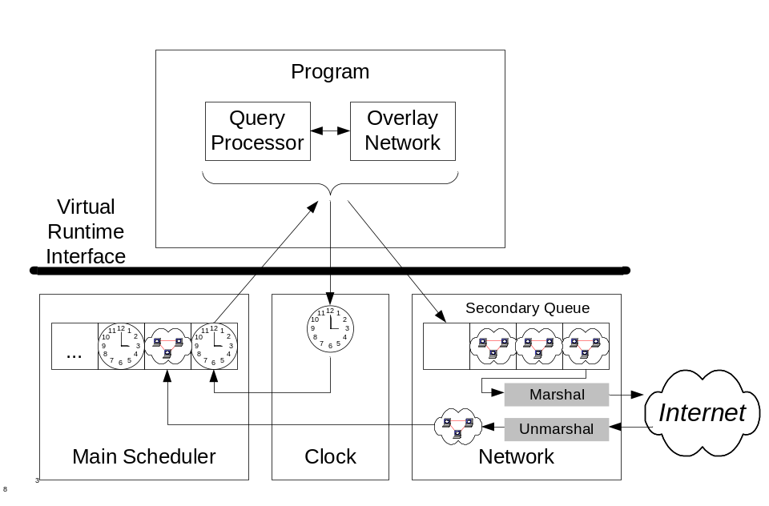
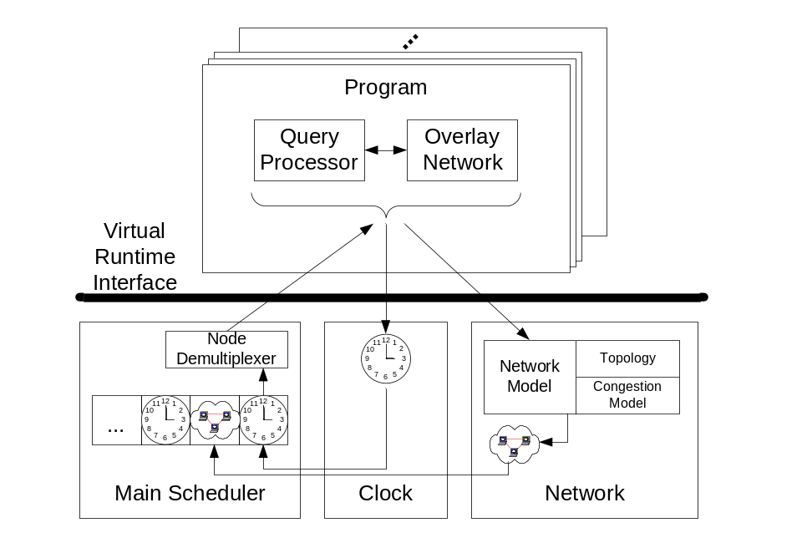
Architecture Overview
Same Code
Physical Runtime
Simulation
Notes:
Just show off same code / I don’t have time to discuss the details below the VRI, but they are in our paper

Slide 17
Non-Blocking Iterator
Problem: Traditional iterator (pull) model is blocking
  This didn’t matter much in disk-based DBMSs
Many have looked at this problem
  Turns out none of the literature fit naturally
  Recall: event-driven, network-bound system
Our Solution: Non-blocking iterator
  Always decouple control flow from the data flow
    Pull for the control flow
    Push for the data flow
  Natural combination of DB and Net SW engineering
    E.g. “iterators” meets “active messages”
    Simple function calls except at points of asynchrony
Notes:
Disk-based DBMS -> w/ Network I/O which is usually compartively long latency and underutilized, the same or differenent I/O sources may be able to handle additional requests
Our Solution = we designed a new solution, a non-blocking iterator
Iterator = comes from databases, “active messages” = comes from networking
Simple function call = which we illustrate in the next slide

Slide 18
Non-Blocking Iterator (cont’d)
(Local) Index Join
Result
data
probe *
Data S
Data R
Selection 2
Result
Join R & S
Selection 1
Join R & S
Join R & S
Join R & S
Selection 1
data
Selection 2
probe *
probe s=x
Result
Data R
data
Data S
PIER Backend
Selection 1
Selection 2
Stack
probe *
probe s=x
data
data
Data -- R
Data -- S
Notes:
More detail in talk about function calls and point out whats going on, use laser

Slide 19
Query Dissemination
Problem: Need to get the query to the right nodes
  Which are they?
  How to reach just them?
Akin to DB “access methods” steering queries to disk blocks
  Traditional DB indexes not well suited to Internet scale
  Networking view: content-based multicast
    A topic of research in overlay networks
    Note IP multicast not content-based: list of IP addresses
Our solution: leverage DHT
  Queries disseminated by “put()-ing” them
  E.g., DHT can route equality selections natively
  For more complex queries, we add more machinery on top of DHTs
    E.g. range selections
    E.g. more complex queries
Notes:
TRANSITION FROM PREVIOUS SLIDE = local dataflow implementation => distributed issues
We do not have time to go into how these techniques work.

Slide 20
Hierarchical Operators
We use DHTs as our basic routing infrastructure
  A multi-hop network
  If all nodes route toward a single node, a tree is formed
  This provides a natural hierarchical distributed QP infrastructure
Opportunities for optimization
  Hierarchical Aggregation
    Combine data early in path
    Spread in-bandwidth (fan-in)
  Hierarchical Joins
    Produce answers early
    Spread out-bandwidth
15
0
1
14
2
13
3
12
4
11
5
10
6
9
8
7

Slide 21

Hierarchical Aggregation
1
6
1
1
3
1
1
1

Slide 22
Hierarchical Joins
A12
A21
A32
Assume a cross product
3 R tuples and 3 S tuples
= 9 results
A23
A22
A13
A31
R1
R3
R3
R2
R2
S2
S2
A33
S1
S3
A11
R1
R1
S1
S1
S3
S3

Slide 23
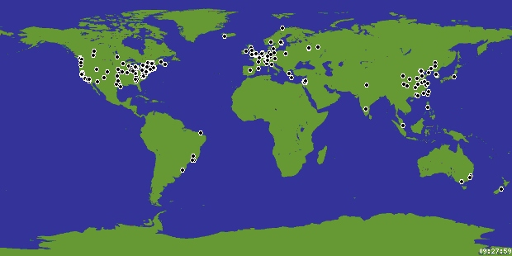
PIER Status
Running 24x7 on
400+ PlanetLab
nodes (Global
test bed on 5
continents)
Demo application
of network
security monitoring
Gnutella proxy implementation [VLDB 04]
Network route construction with recursive PIER queries [HotNets 04]
Notes:
Gnutella- 50 pier nodes, 100,000 nodes, 63k queries in one hour
Last bullet – example of pulling database technology into network fabric

Slide 24
Future Work
Continuing Research
  Optimization
    Static optimization vs. Distributed eddies
    Multi-Query optimization
  Security
    Result fidelity
    Resource management
    Accountability
    Politics and Privacy
Notes:
Discussion of these topics in the paper

